Slide 1


Black Box Entropy Estimation
Technical Director: Kerry McKay
Team Members: Omar Abbas, Daniel Le, Alinta Wang, Gabriel Goetten
Notes:
Omar

Slide 2
Agenda
Timeline
Overview
About RNG
Entropy
Numeric Distributions
Linear Regression
Logistic Regression
Progress and Next Steps
Q & A
Gabe, Change above points as you want, just a few points from provided material by Kerry
Notes:
Omar

Slide 3
Project timeline
SEPT 10
SEPT 24
OCT 8
OCT 22
NOV 5
DEC 3
analyze results
begin research and exploration
setting up of environment
preparing data sets for model
getting data through logistic regression
analyze results and derive conclusions
look to future improvements and possibilities
min-entropy, pseudo-random number generators, cryptography, methodologies
began setting up in Colaboratory and experimenting with Tensorflow
imported models from other projects and topics
getting data values from varying types of distributions
importing data
analyzing the data sets
analyze and experiment through logistic regression
began by looking at linear regression
later switching to logistic regression approach
analyze the model and receive results from logistic regression with imported data
test using different data sets and multiple results
Notes:
Alinta

Slide 4
Overview
Randomness is a critical in ensuring the security of cryptographic systems
Used for key generation, padding, nonces, and initialization vectors (IV)
A sequence of numbers is random if it is unpredictable:
Knowing previous outputs of sequence do not help in predicting future outputs
Knowing that a sequence is random for certain is impossible
Necessary unpredictability can be provided by using external noise sources, but we need a method of approximating the unpredictability of a noise source
Notes:
Alinta

Slide 5
Random Number Generation (RNG)
A Random Number Generator (RNG) can be implemented as a hardware device or software algorithm
The function of a RNG is to take a probability distribution and generate a number
A RNG is typically deterministic or a Pseudo Random Number Generator
  Given the same input, the PRNG will always produce the same output
  Not safe to use in secure cryptographic applications
A non-deterministic RNG should be considered in scenarios in which security is critical
To achieve an acceptable level of security with a RNG, we need to consider a source of entropy that provides a sufficient amount of randomness
Notes:
Gabriel

Slide 6
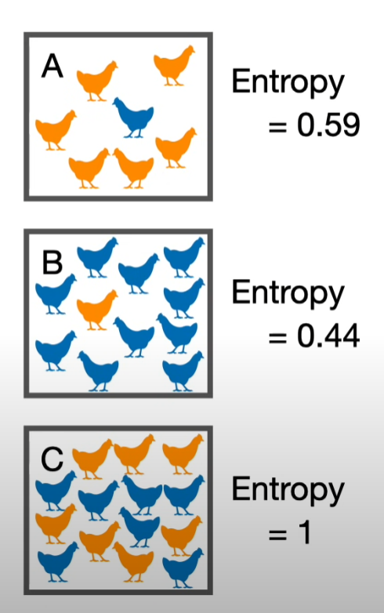


Entropy
Entropy is a way to measure uncertainty or disorder in a system
  The higher the entropy, the lower the certainty
Entropy can be reliably obtained from our surroundings, which is chaotic and uncertain
Shannon Entropy
  Average uncertainty of a space of probabilities
Min entropy
  Only looking at highest probability
Used to quantify the similarity or difference in # of Orange or Blue chickens in each area

Slide 7
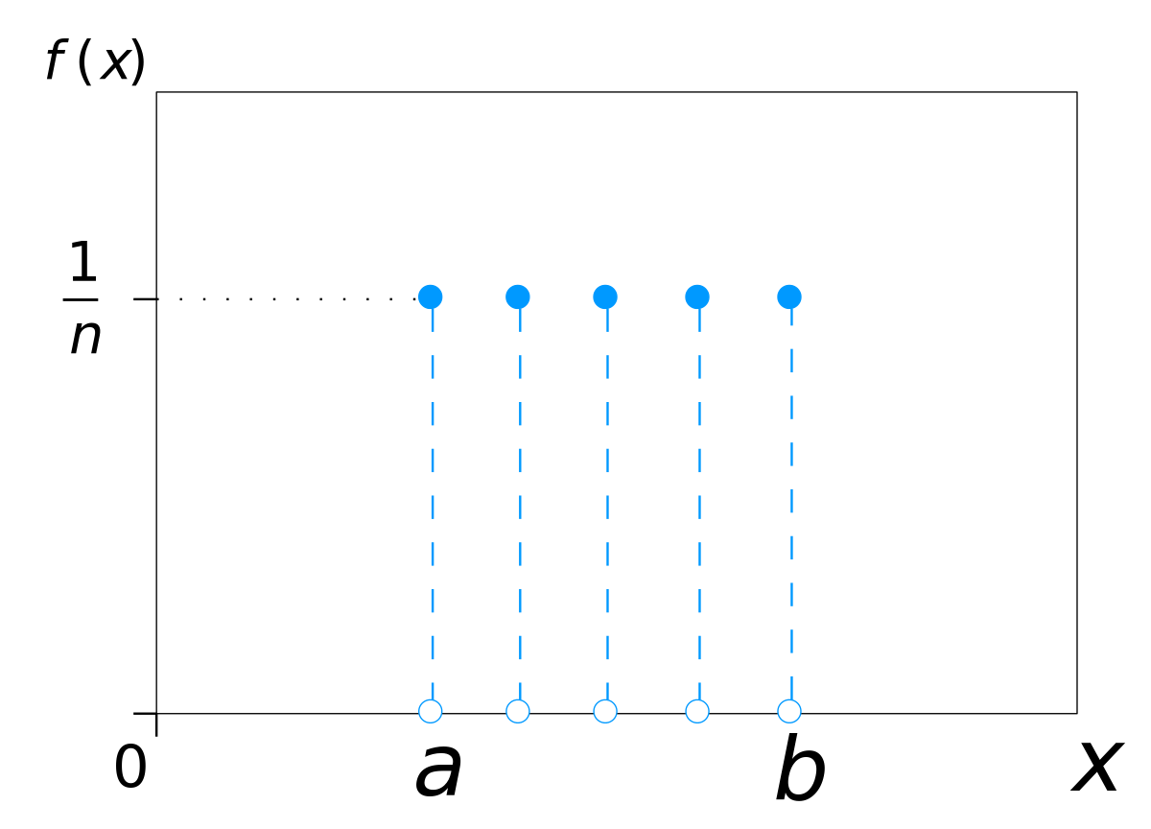
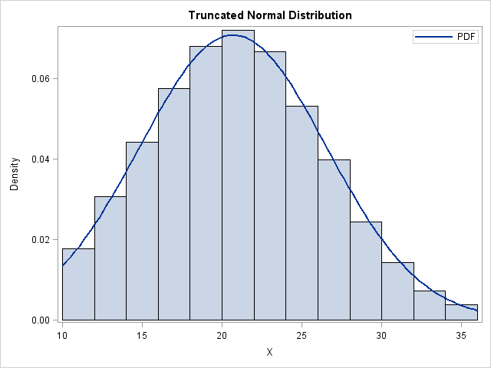
Numeric Distributions
Datasets simulated for modeling were accumulated through varying distributions.
Discrete Uniform Distribution
Truncated Normal Distribution
Notes:
Alinta

Slide 8
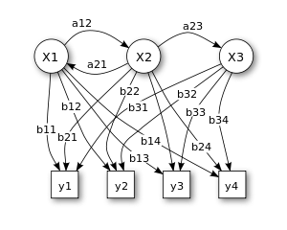
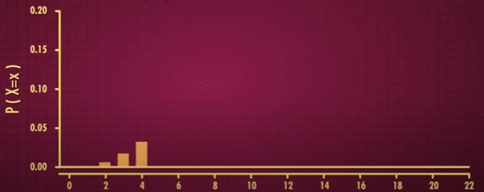
Numeric Distributions
Datasets simulated for modeling were accumulated through varying distributions.
Markov Model
Binomial Distribution
Notes:
Alinta

Slide 9
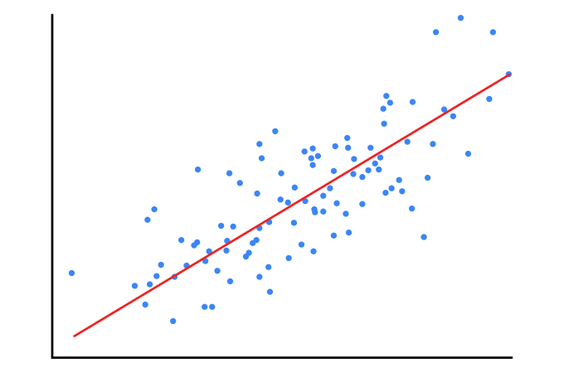

Linear Regression
In statistics, linear regression is a linear approach to modelling the relationship between a dependent variable and one or more independent variables. Let X be the independent variable and Y be the dependent variable.
y = mx + c
m : slope of the line
c : y intercept
Loss function:
Notes:
Daniel

Slide 10
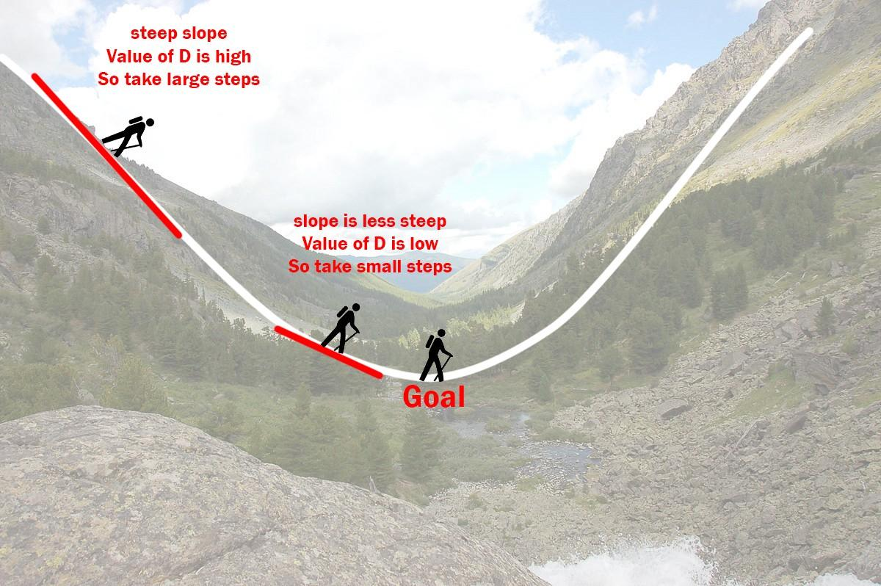
Gradient Descent
Hypothesis
Let m = 0, c = 0. Let L be our learning rate
(0.01 for good accuracy)
Learning rate gives the rate of speed where the gradient moves during gradient descent. Setting it too high would make your path unstable, too low would make convergence slow. Put it to zero means your model isn’t learning anything from the gradients.
Notes:
Daniel

Slide 11
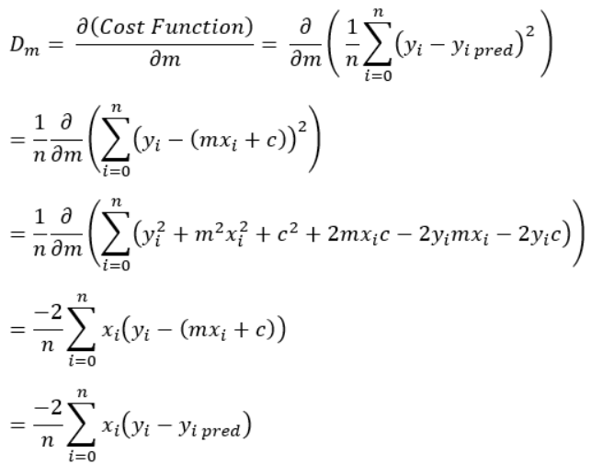
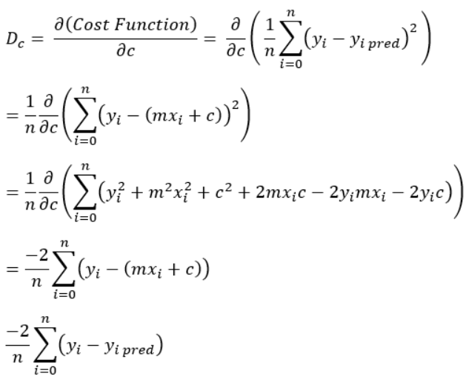

2. Calculate partial derivative of cost function with respect to m and c
3. Update value m and c

Slide 12
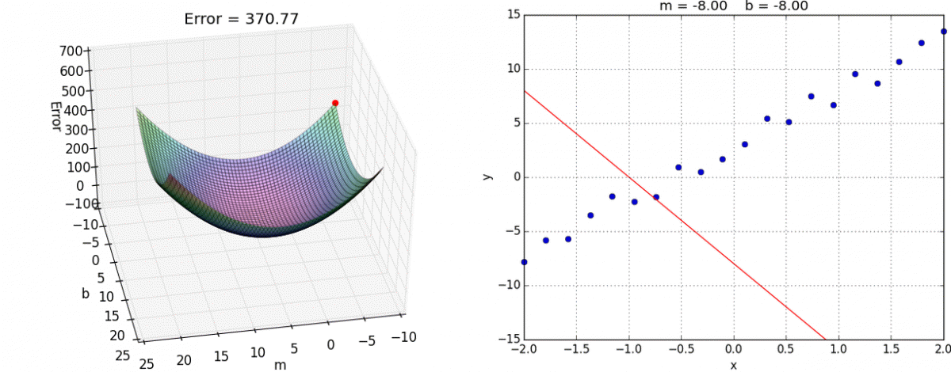
Linear Regression with Gradient Descent
4. Repeat until cost function (error) is small
Notes:
Daniel

Slide 13
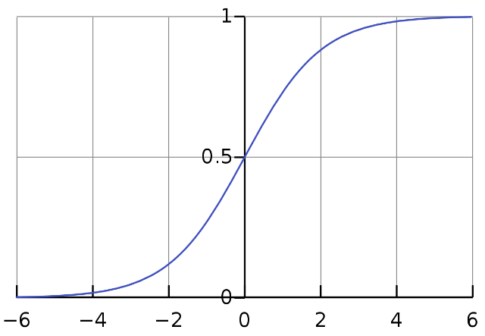

Logistic Regression
A supervised ML algorithmic technique used to solve classification problems
Used to model a certain class or event such as pass/fail, win/lose, 1/0
Predicted value is categorical
2 Types: Binary Classification or MultiClass Classification
Uses Sigmoid (aka Logistic) Function
Unlike Linear Regression which provides a continuous output, Logistic Regression provides a discrete one
Notes:
Omar

Slide 14
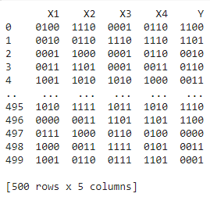
Progress and Next Steps
Current Progress:
Google colab instance used to run numeric distribution data (CSV files with 1,000,000 rows of binary data)
Starting out with a truncated Binomial distribution file with only 10,000 (colab resource limitation)
CSV file taken and dissected into 4 independent (X1, X2, X3, X4) and 1 dependent (Y) variables and put into a python dataframe (500 X 5)
Next Steps:
All columns in dataframe to be converted into integer value and used in linear and logistic regression techniques described
Generate basic accuracy metrics (Using a confusion matrix)
Produce a receiver operating characteristic (ROC) for visualization (AUC..etc.)
Notes:
Omar

Slide 15

Thank you!
Notes:
Omar

